Slide 1







SPECTRE-HD
Safe Processing Ecosystem for Trusted Reuse of Health Data
SPECTRE-HD

Slide 2
SPECTRE-HD
Goals
Value Proposition
Scale data-driven services & solutions
Deploy services as part of a hospital platform
Facilitate safe sharing of data in context of EHDS
Pilot: rare diseases – identify, collect & share
Leverage data in free-form clinical notes
Empower data stakeholders
Bring users to data, rather than data to users
Harmonize data collection in registries
Standardize for exchange (Snomed CT, OMOP)
Align with Sciensano on a minimal RD dataset
Supports FAIRification of health data
Rare diseases pilot:
  Accrue knowledge in the field of rare diseases
  Improve patient’s quality of life as a result of a decreased time to diagnosis and guidance to optimal care path
  Less burdeon on health system
Promote a consistent, trustworthy and efficient set-up for the reuse of health data for research, innovation, policy-making and regulatory activities
Notes:
Vermeld hier duidelijk het doel of het probleem dat u aanpakt. Leg uit waarom uw project relevant is en wat het wil bereiken.
Verduidelijk de waarde of voordelen van het project. Leg uit wat er in zit voor het hergebruik van data.

Slide 3



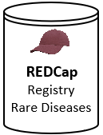





SPECTRE-HD
Solutions and challenges
CRRD
Central Registry for Rare Diseases
CSI
Cohort Selection and Identification
Do we have diabetes patients with renal insufficiency and who had an acute coronary syndrome of type instable angor in the last 2 years?
M5-6
HDIP
Health Data Integration and Preparation
M3
M3
M2
FHIR interoperability
textual concepts
textual concepts
Standardization
CDM to OMOP
Data Upload
NLP
IRIS
clinical
notes
clinical
notes
structured
data
Data Catalogue
construction
publication
SNOMED CT
ORPHAcodes
SNOMED CT Terminology
pseudonymize
Pseudonymization
clinical notes
structured data
M4
1. Identify RD patients
2. Collect data in RD registry
3. Share RD data
Shared local data services

Slide 4





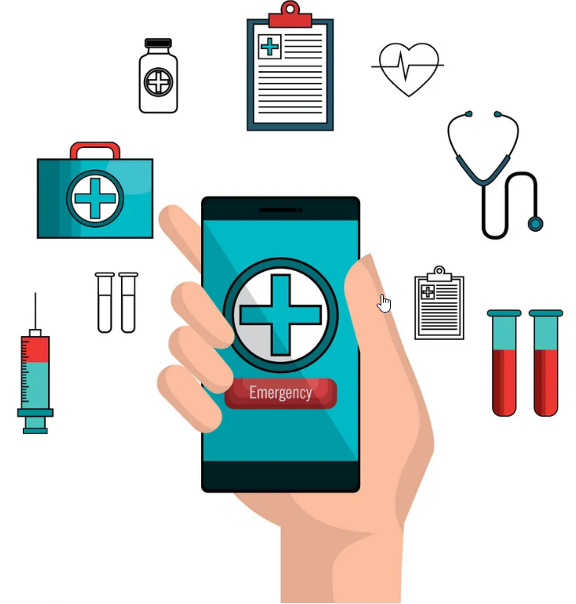



SPECTRE-HD
IRIS
HDIP
HDIP
HDIP
data
metadata
M7
HDAP
Health Data Access and Processing
Data Processing
Published
Data Catalogues
IRIS
IRIS
data
data
HDIP
Trusted Research Environment
Data request
Store front
HDIP
metadata
metadata
data
metadata
IRIS
HDIP
Notes:
Identify RD patients
NLP as a standalone capability, extremely useful for physicians
Standardize data collection (same platform,
Metadata Catalogue

Slide 5
Closing statement
SPECTRE-HD
SPECTRE-HD enables hospitals and other actors to safely reuse existing health data for the ultimate benefit of patients and society, by promoting data-driven services and solutions that leverage both structured and unstructured data.
Notes:
Sluit uw pitch af door de belangrijkste punten samen te vatten en de kernboodschap te herhalen. Laat een gedenkwaardige eindindruk achter.
Mentionné vos partenaires/vermeld uw partners

